Slide 1
Melanoma
Group 5: Angela Gaudio
Priscilla Lin
Xi Yang

Slide 2
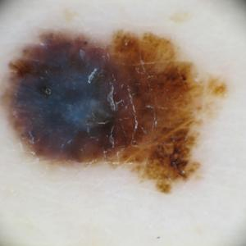
Melanoma
Melanoma is an uncommon form of skin cancer, however,
it is one of the most dangerous if not found early on. It forms
in one of the deepest layers of our epidermis, the melanocytes.
Melanoma cells are used to create melanin suggesting most
early signs of cancer would be seen as brown or black, however,
Sometimes they do not produce melanin making them appear pink,
tan, or white. Melanoma can appear anywhere on the human body
such as hands, face, legs, feet, back, neck, etc.
A typical melanoma image

Slide 3
Melanoma Prediction
Dataset:
Training: 10000 images of skin cancer (5000 benign, 5000 malignant)
Testing: 1000 images of skin cancer (500 benign, 500 malignant)
Algorithm:
CNN (Convolutional Neural Network): well-suited for image recognition and processing tasks

Slide 4
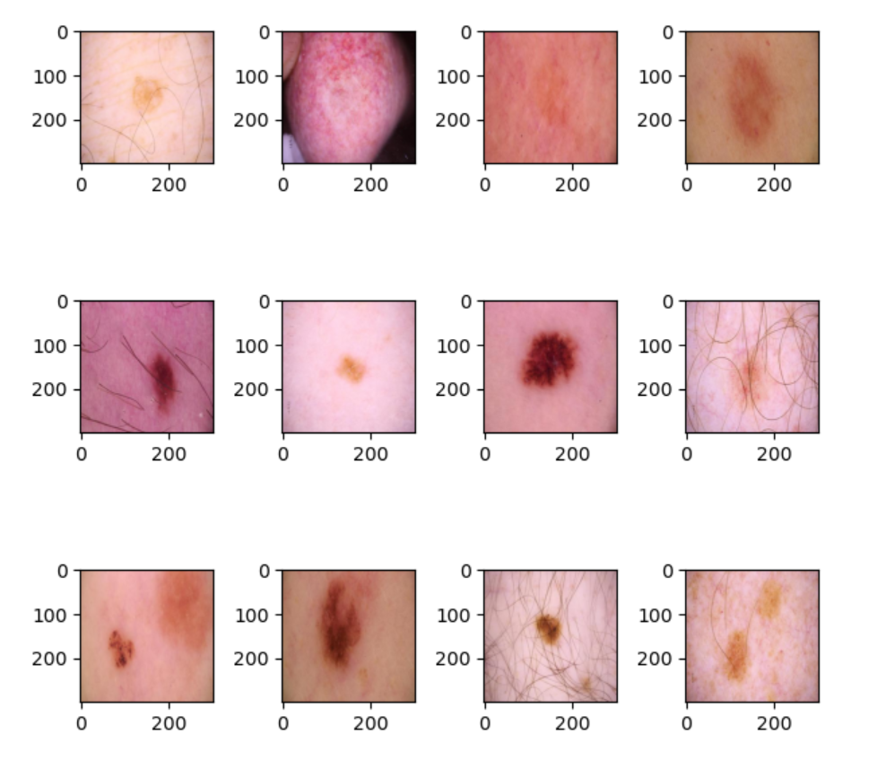
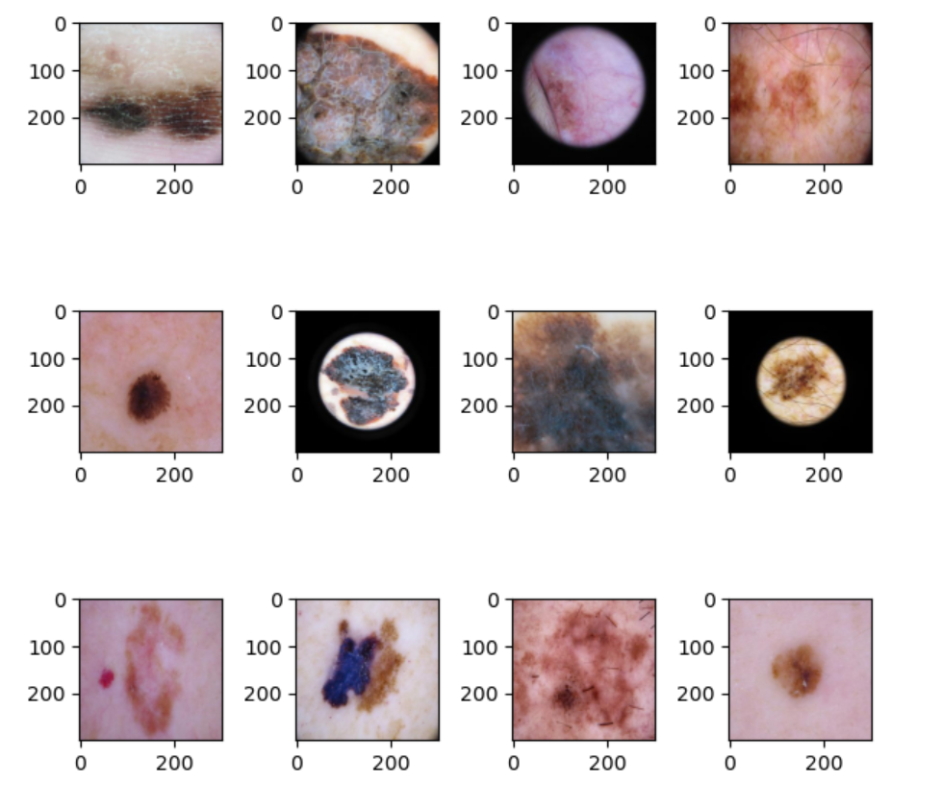
Melanoma Prediction
Benign skin cancer Melanoma

Slide 5
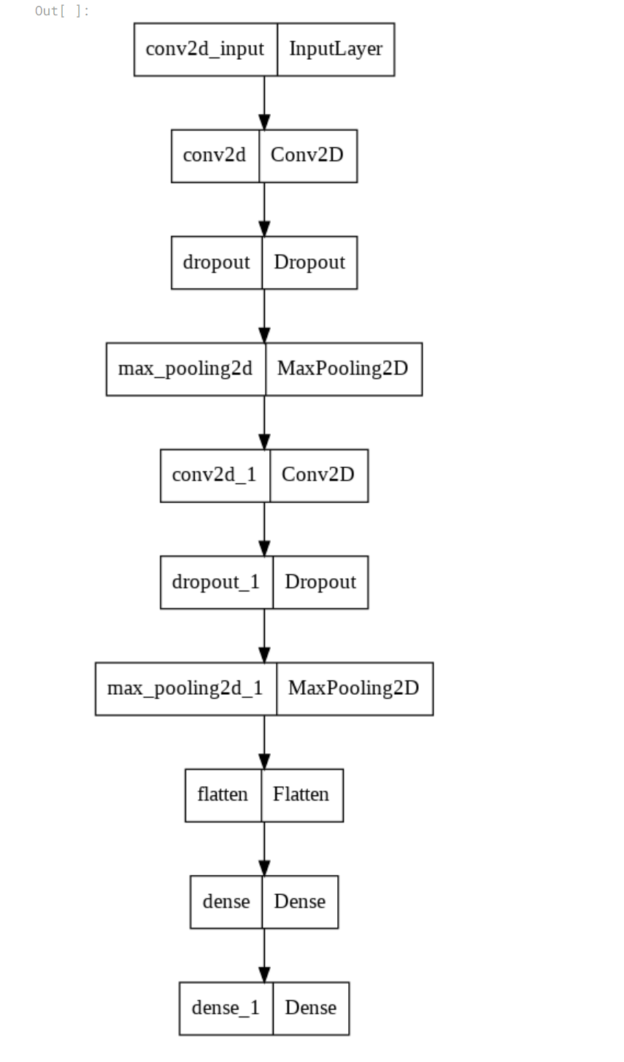
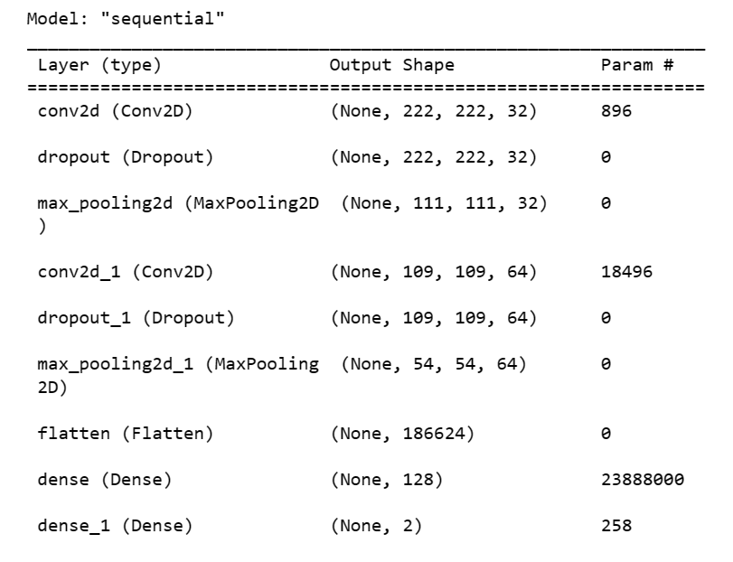
Melanoma Prediction

Slide 6
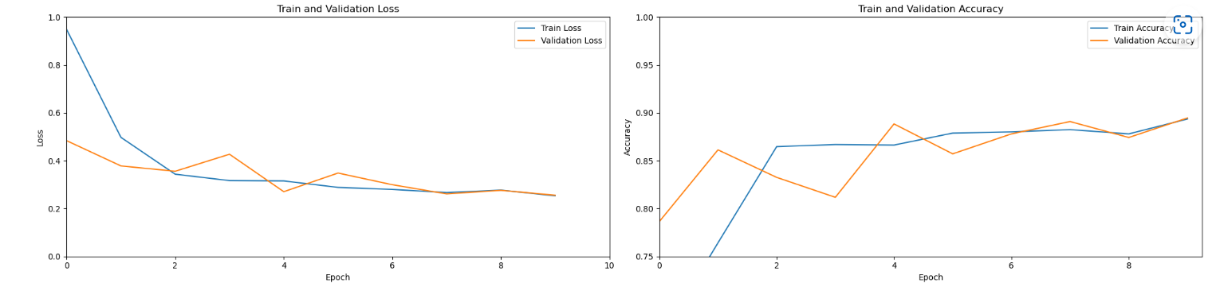
Melanoma Prediction

Slide 7
Prediction of Melanoma
Datasets:
Kaggle Melanoma training: train.csv
Kaggle Melanoma test: test.csv
Algorithms Used:
Random Forest (RF)
Support Vector Machines (SVM)

Slide 8
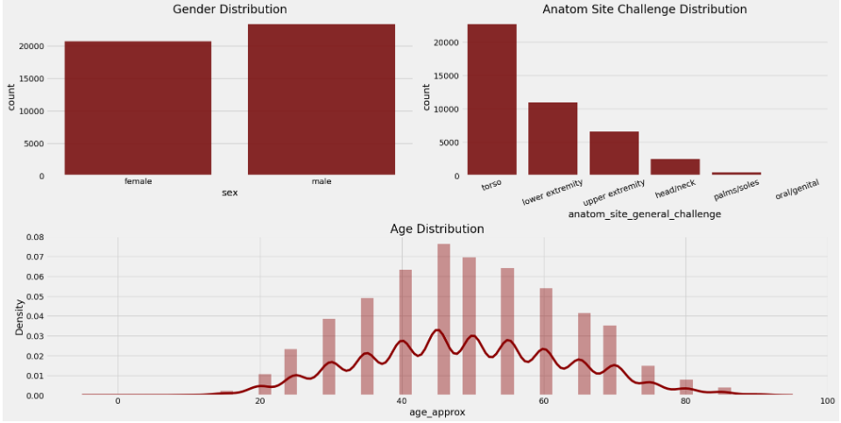
Dataset

Slide 9
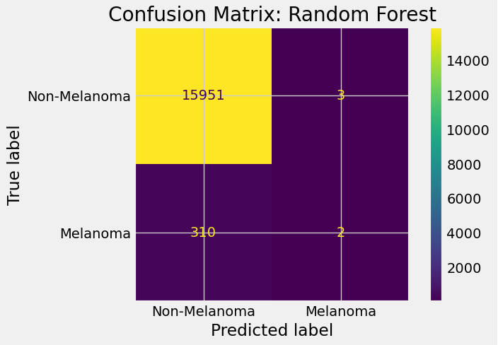
Random Forest

Slide 10
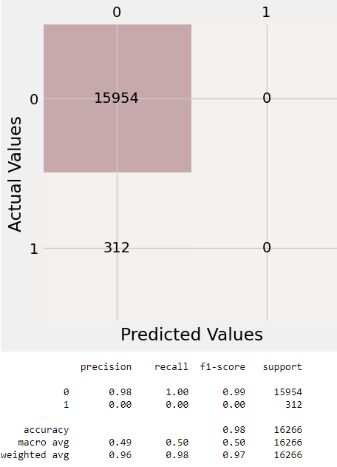
Support Vector Machines (SVM)

Slide 11
Melanoma Gene Expression
Dataset:
RNA sequences expression: MDB_SKCM_RNASeq to joma.csv
Human DNA gene list: genage_human.csv
Algorithm:
K-Means Clustering; Principal Component Analysis (PCA) - Dimensionality Reduction; Select K Best; Find frequent high expression

Slide 12
Data Process
●RNA sequence of gene expression dataset was used due to the wide coverage of genes
●Human DNA gene list was obtained as target gene list
●Then extract the targeted gene expression values from RNA sequence list for further analysis

Slide 13
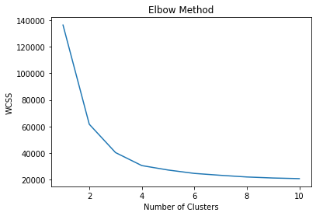
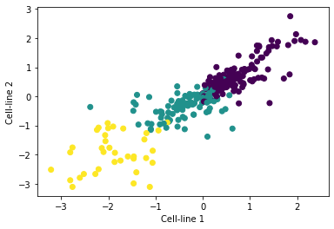
K-Means Clustering

Slide 14
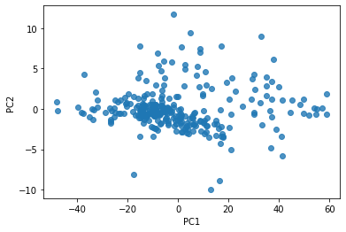
Principal Component Analysis (PCA)
- Dimensionality Reduction

Slide 15
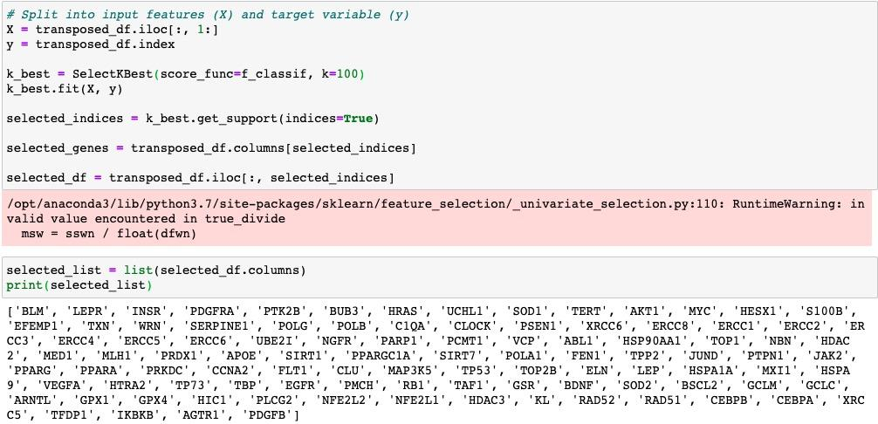
Select K-Best

Slide 16
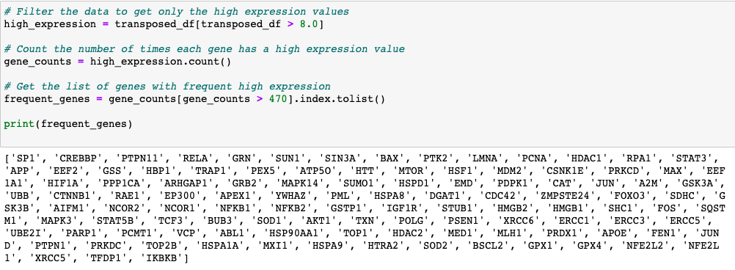
Find frequent high expression
● Finding the genes with frequent high expression using comparison and counting

